Slide 1
Templates
Religious Structure and Holy Sites
Whole Map

Slide 2
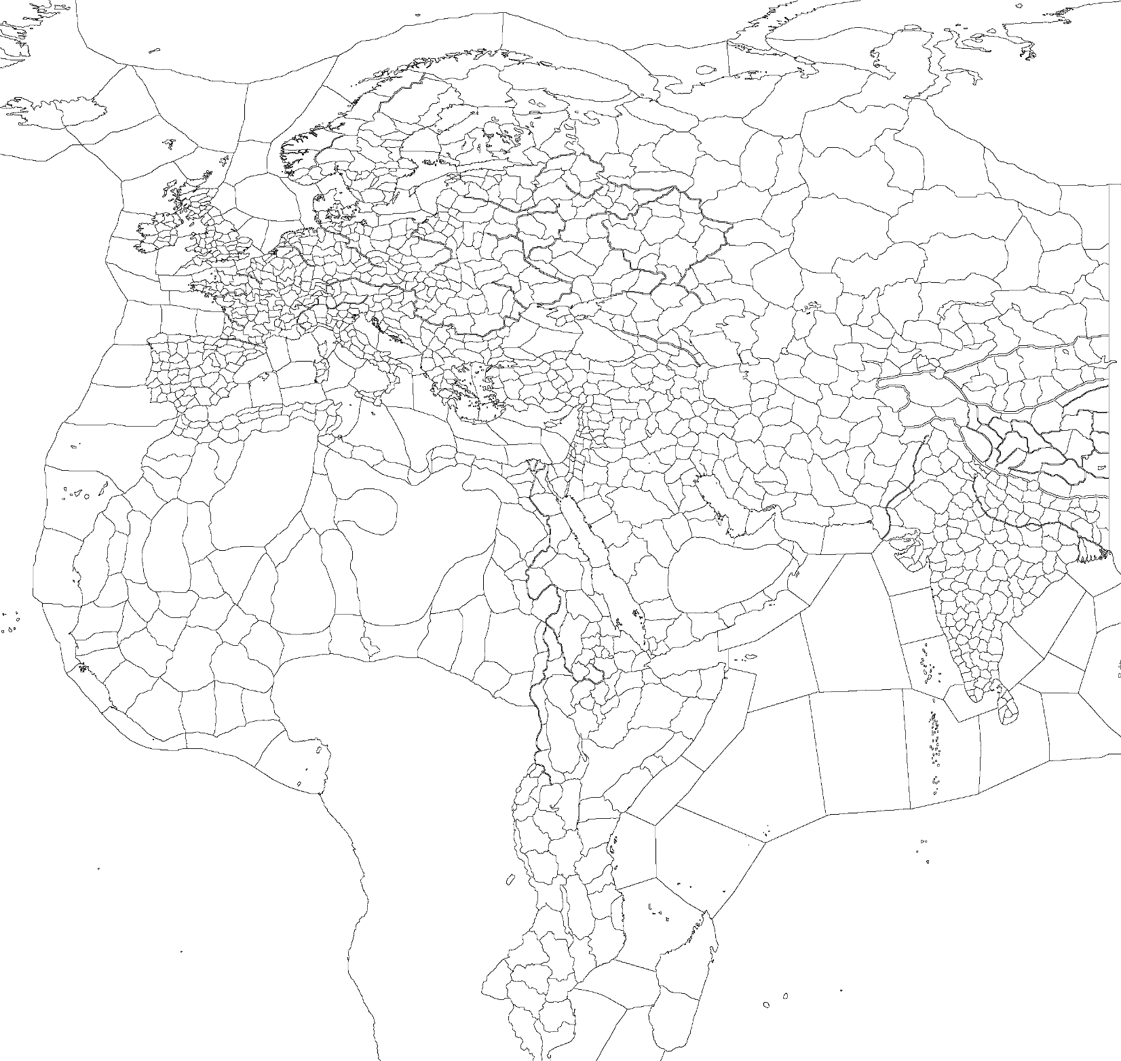
Template (Whole World)
Religious Structure and Holy Sites
Shared Holy Sites
Mainstream Religion and its Heresies:
1
Catholic
Heresies: Text, Text, Text
Autonomous Religions:
2
Text
3
Text
4
Text
5
Text
6
Text
7
Text
8
Text
9
Text
10
Text
11
Text
Religion: unreformed religion
Religion: reformed religion

Slide 3
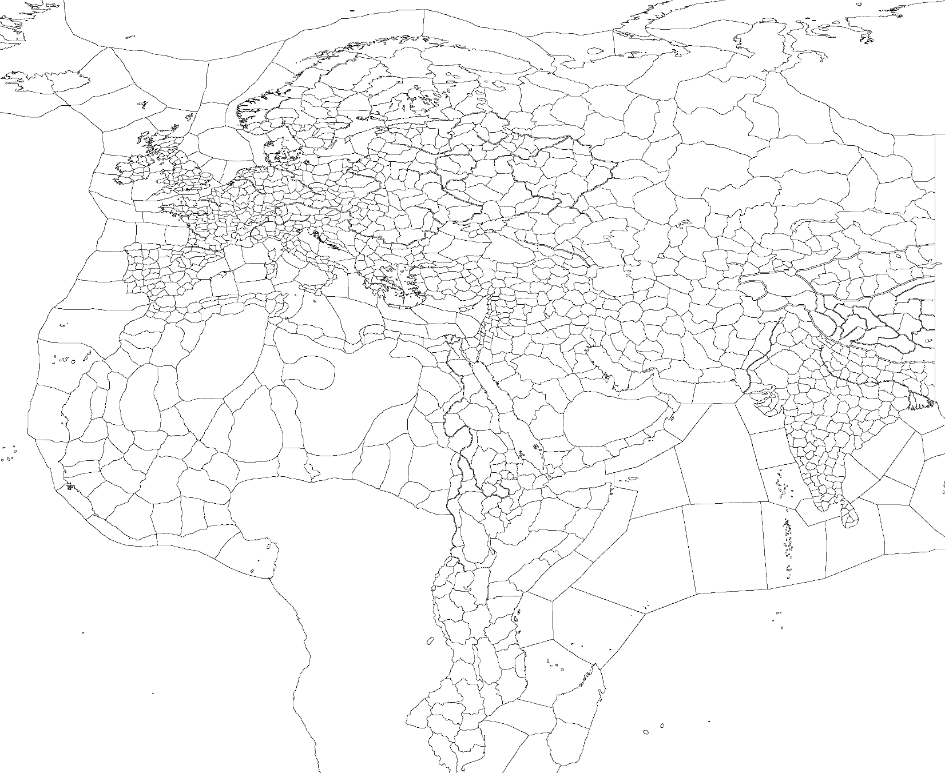
Template (Western Europe)
Religious Structure and Holy Sites
Shared Holy Sites
Mainstream Religion and its Heresies:
1
Catholic
Heresies: Text, Text, Text
Autonomous Religions:
2
Text
3
Text
4
Text
5
Text
6
Text
7
Text
8
Text
9
Text
10
Text
11
Text
Religion: unreformed religion
Religion: reformed religion

Slide 4

Template (Middle East)
Religious Structure and Holy Sites
Shared Holy Sites
Mainstream Religion and its Heresies:
1
Catholic
Heresies: Text, Text, Text
Autonomous Religions:
2
Text
3
Text
4
Text
5
Text
6
Text
7
Text
8
Text
9
Text
10
Text
11
Text
Religion: unreformed religion
Religion: reformed religion

Slide 5
Template (Eastern)
Religious Structure and Holy Sites
Shared Holy Sites
Mainstream Religion and its Heresies:
1
Catholic
Heresies: Text, Text, Text
Autonomous Religions:
2
Text
3
Text
4
Text
5
Text
6
Text
7
Text
8
Text
9
Text
10
Text
11
Text
Religion: unreformed religion
Religion: reformed religion

Slide 6
Templates
Religious Structure and Holy Sites
Partial Map

Slide 7
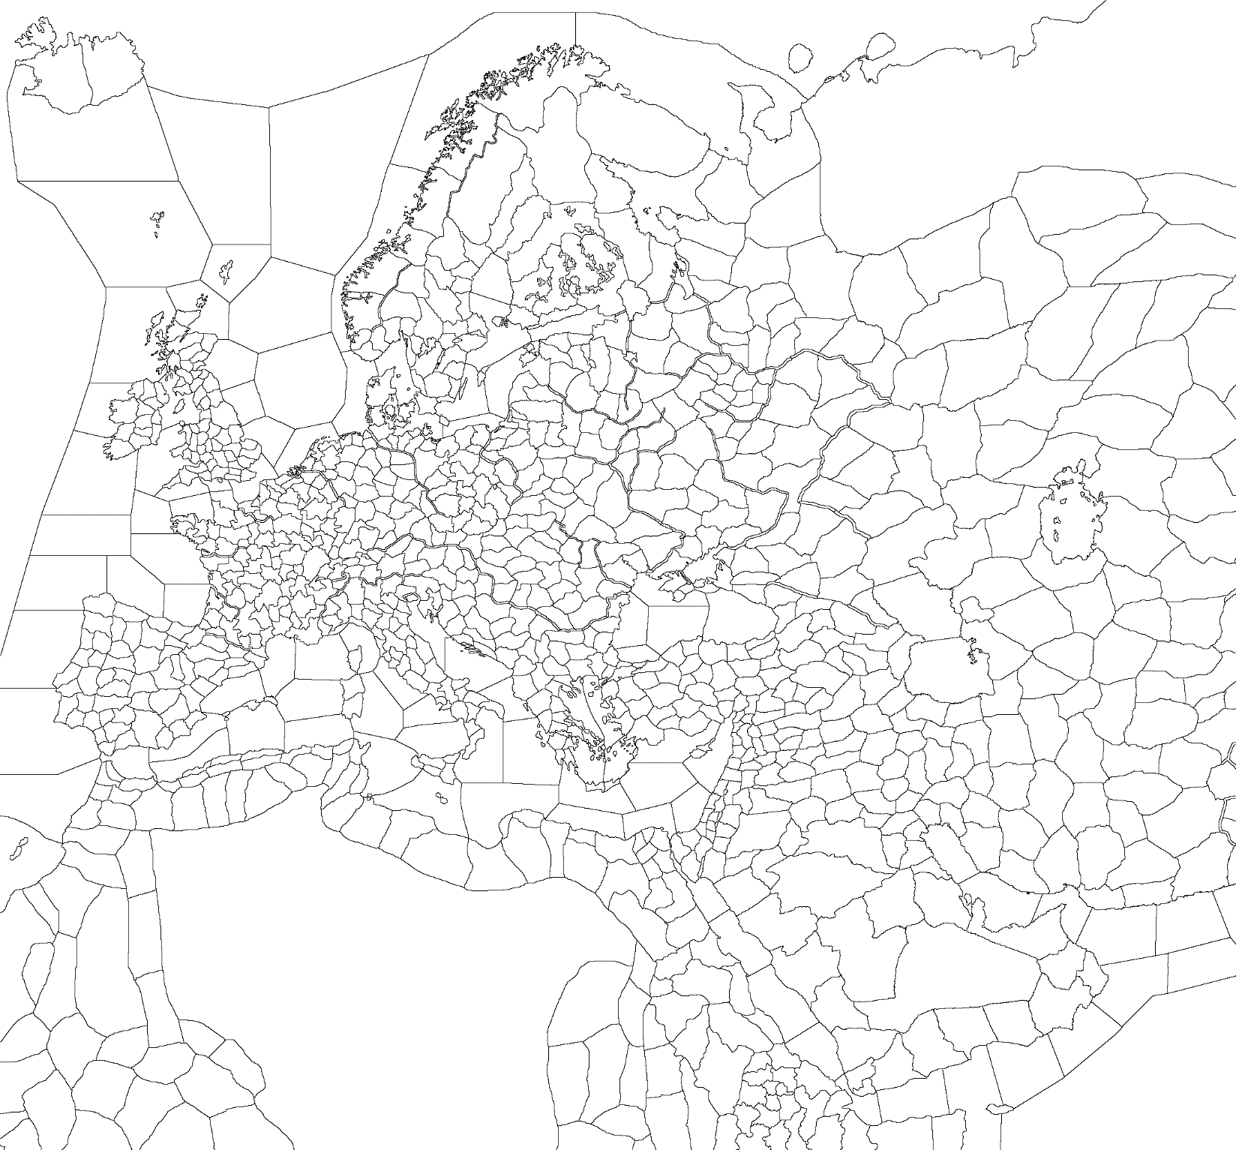
Template (Western)
Religious Structure and Holy Sites
Shared Holy Sites
Mainstream Religion and its Heresies:
1
Catholic
Heresies: Text, Text, Text
Autonomous Religions:
2
Text
3
Text
4
Text
5
Text
6
Text
7
Text
8
Text
9
Text
10
Text
11
Text
Religion: unreformed religion
Religion: reformed religion

Slide 8

Template (Eastern)
Religious Structure and Holy Sites
Shared Holy Sites
Mainstream Religion and its Heresies:
1
Catholic
Heresies: Text, Text, Text
Autonomous Religions:
2
Text
3
Text
4
Text
5
Text
6
Text
7
Text
8
Text
9
Text
10
Text
11
Text
Religion: unreformed religion
Religion: reformed religion
Text
Text
Text
Text

Slide 9
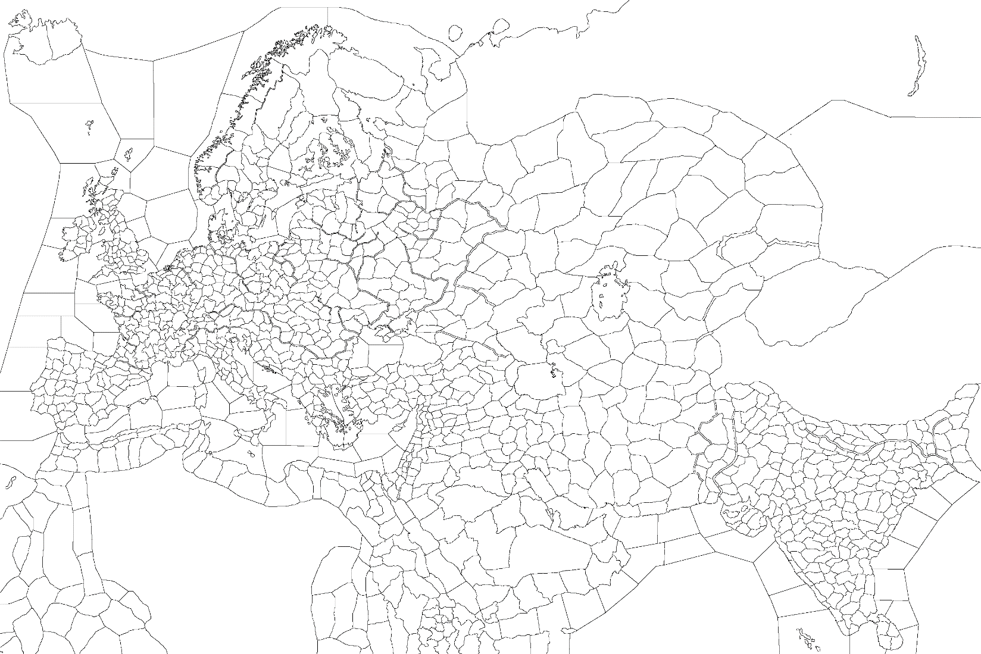
Template (Whole Map)
Religious Structure and Holy Sites
Shared Holy Sites
Mainstream Religion and its Heresies:
1
Catholic
Heresies: Text, Text, Text
Autonomous Religions:
2
Text
3
Text
4
Text
5
Text
6
Text
7
Text
8
Text
9
Text
10
Text
11
Text
Religion: unreformed religion
Religion: reformed religion
Text
Text
Text
Text

